Slide 1
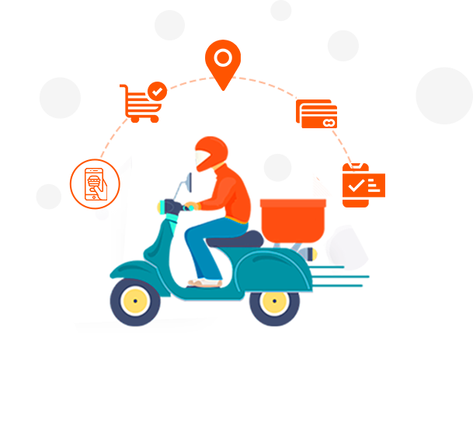
Order Management System
Application Engineering Development
Pranav Arun Kapse
Kishor Satishkumar Kashid
Kaushik Venkat Sai Karanam

Slide 2

Problem Statement
Complicated Ordering Process: Today's delivery system requires users to navigate multiple stores and platforms for a product that is not cost-effective.
Security and Privacy: The matter of concern at hand is the potential security breach caused by the need for users to register and log in to multiple applications separately.
High Operation Cost for organizations: Organizations incur high operational costs due to manual processes, resource inefficiencies, and suboptimal routing.

Slide 3

Proposed Solution
We made an order management system that lets you easily order products from multiple organizations hosted on one application.
With this proposed solution, organizations can significantly reduce operational costs, making it an effective solution for users and enterprises.
The delivery time is reduced since multiple products are delivered together from various organizations.

Slide 4
Working Model
The admin gets a request to create an enterprise. After that, the admin creates an enterprise according to the requirements.
The newly established enterprise now has the privilege to create organizations under its umbrella.
The workflow is now transferred to the organization, where the organization can add new products to its catalog.
The organization also has the ability to add or remove products according to its business requirements.

Slide 5
Working Model
The products produced by the organization are now assigned to their respective enterprise and organizations.
After signing up and creating an account, customers can log in to the application.
After logging in, the customer can select the enterprise, organization, and products from the listed options to place their order.

Slide 6
Working Model
After a customer places an order and completes payment, the workflow is transferred to the delivery partner.
The administrator holds the privilege to create new delivery partners.
The delivery partner can now accept the order for delivery. The order will be marked as complete once the delivery partner delivers the products.
The admin can view the performance of the top 3 enterprises, organizations, and delivery partners.

Slide 7
Important Roles
Admin: The admin role can create enterprises and delivery partners while accessing analytics within the order management system.
Enterprise: The enterprise role is created by the admin; this role can make and manage organizations.
Organization: The organization’s role is created by the enterprise. The organization can add and remove the products according to the business needs.

Slide 8
Important Roles
Delivery Partner: Another important that the admin creates is a delivery partner. The delivery partner can accept the order placed by the customer.
Customer: The customer role is independent in nature; the customer signs up and logins to place the order.

Slide 9
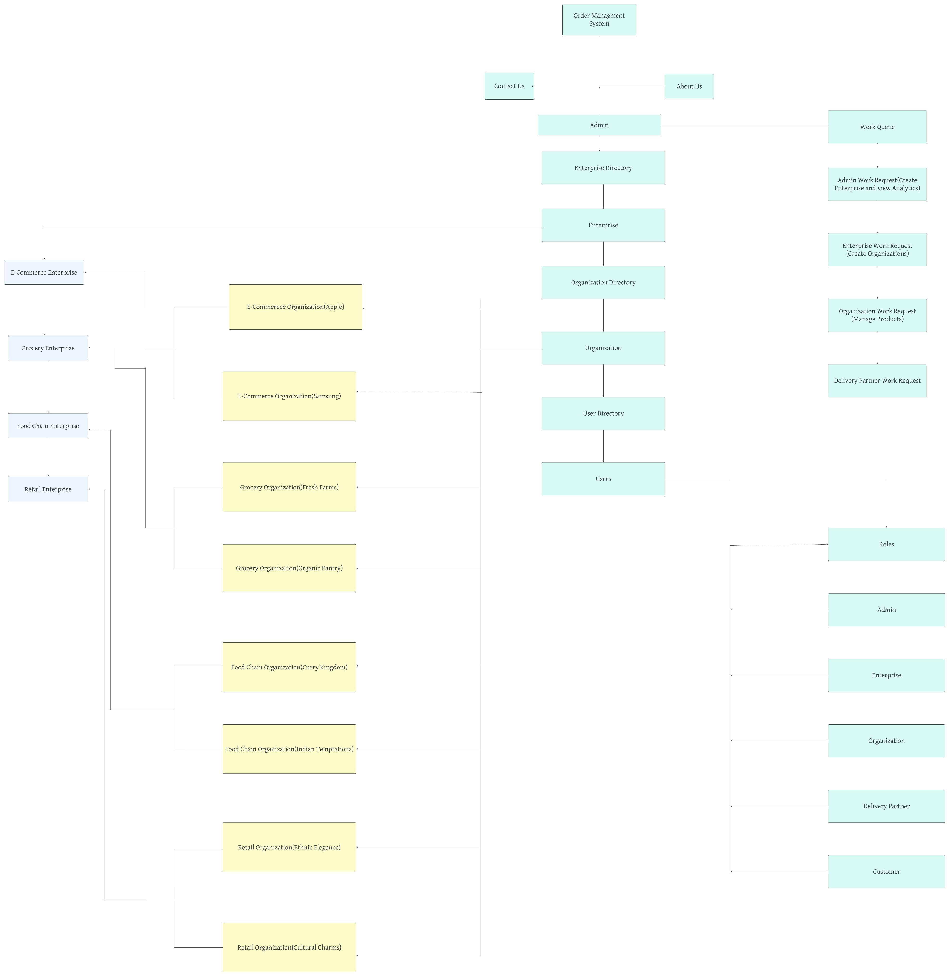
Architecture Diagram

Slide 10
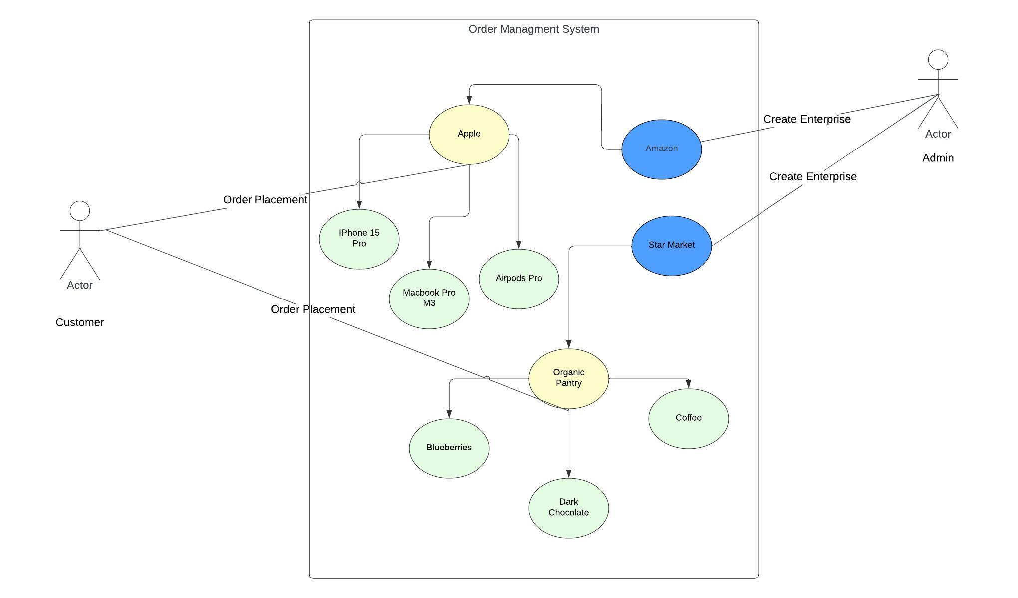
Use Case

Slide 11
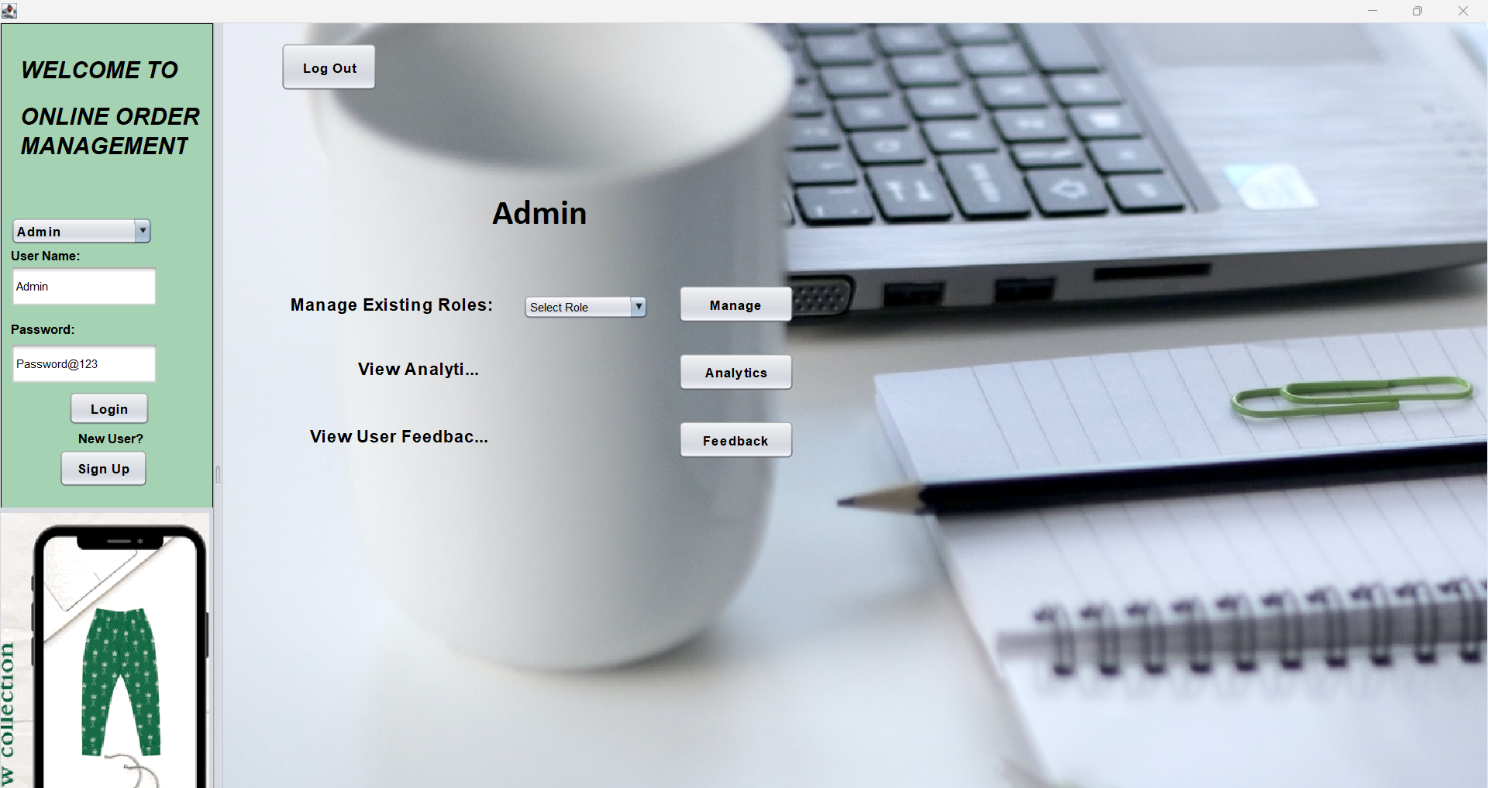

Slide 12
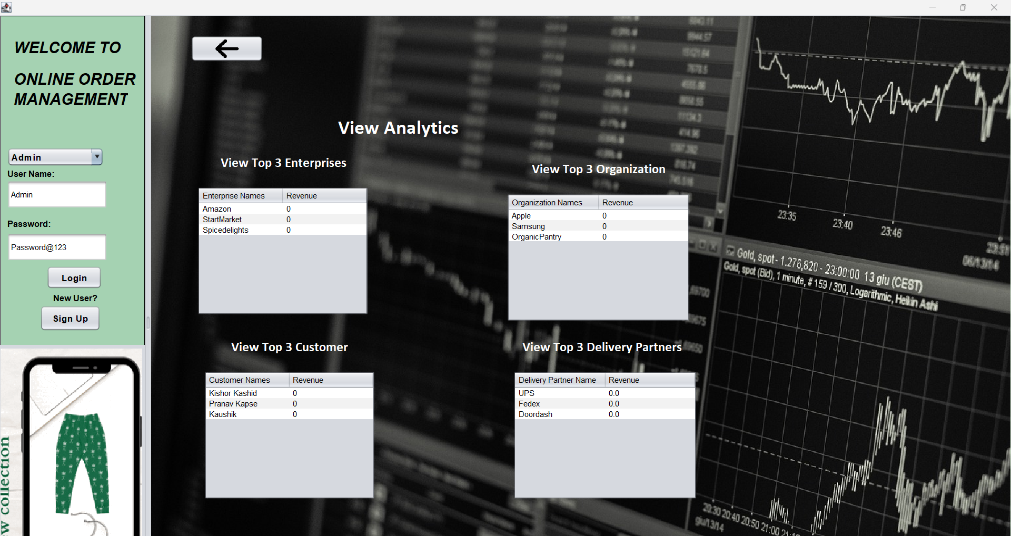

Slide 13
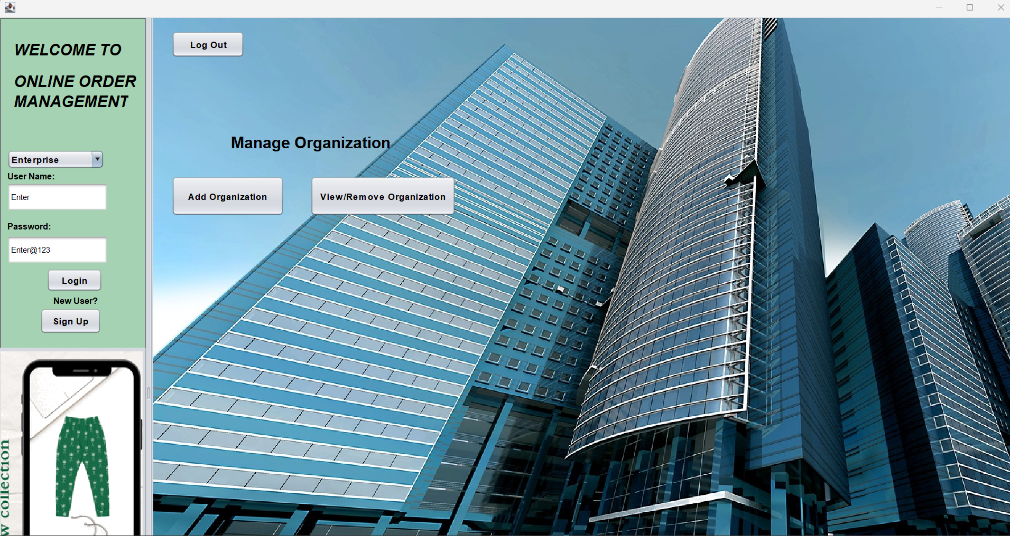

Slide 14
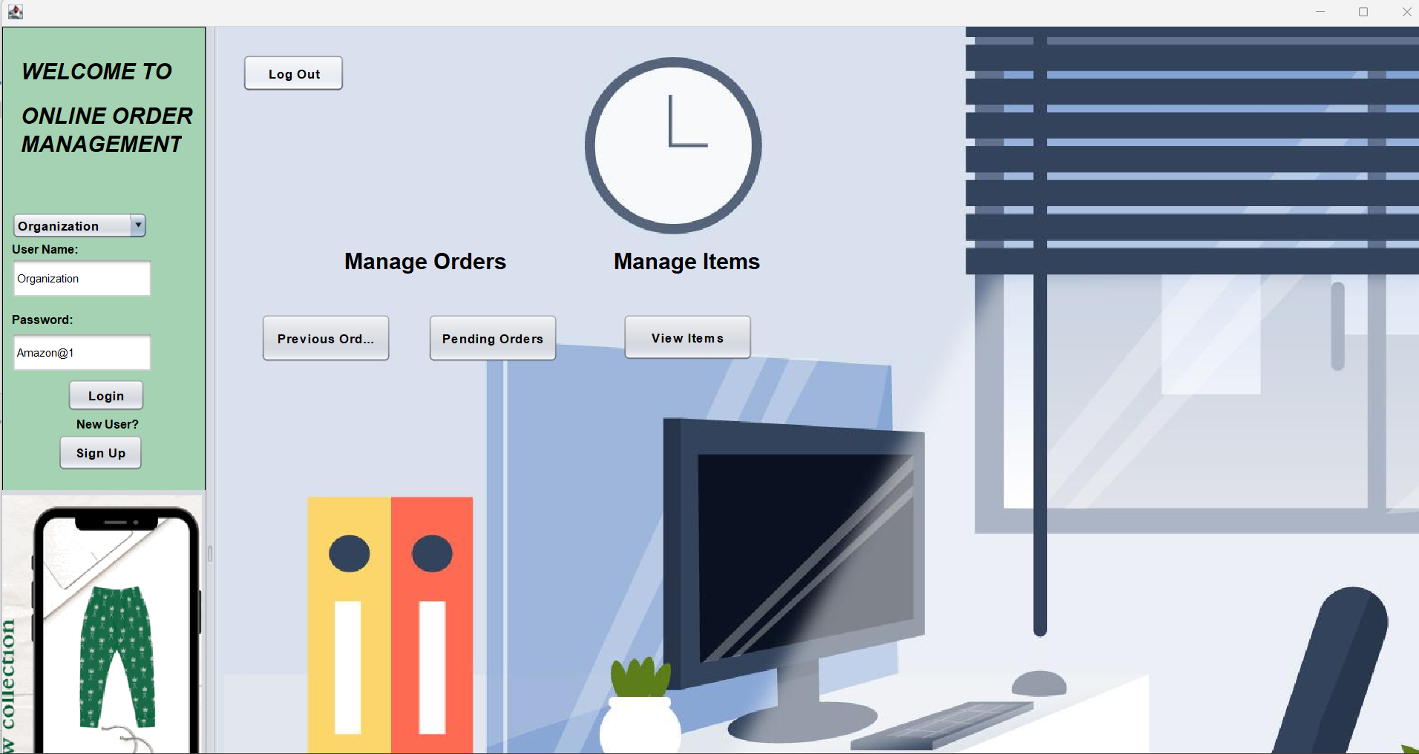

Slide 15
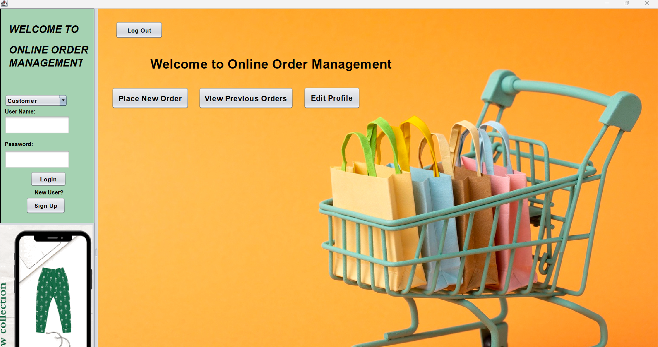

Slide 16
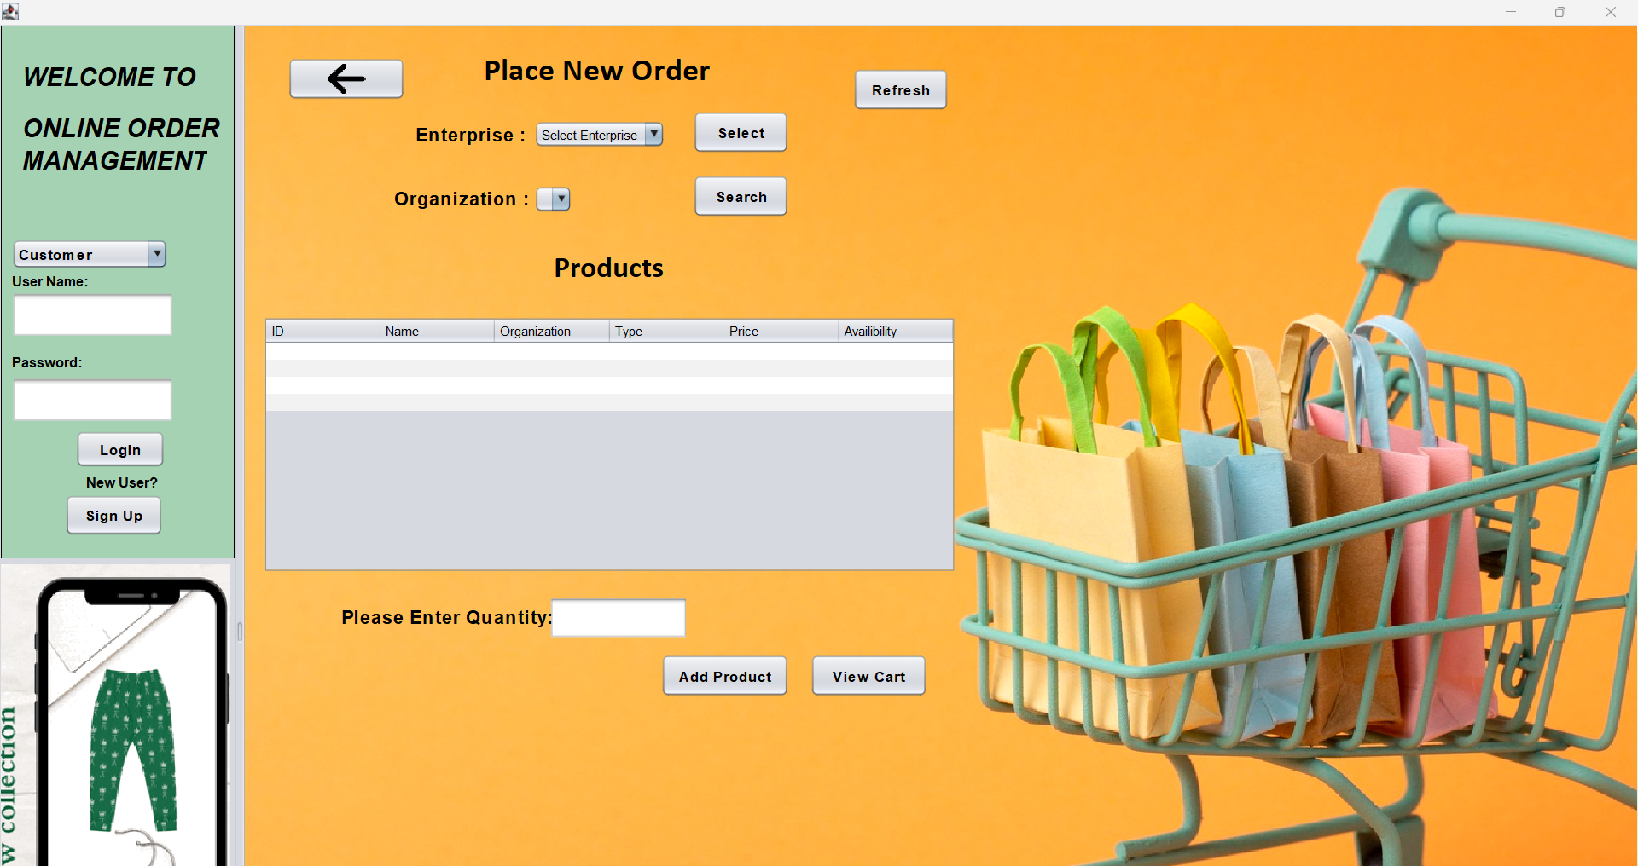

Slide 17
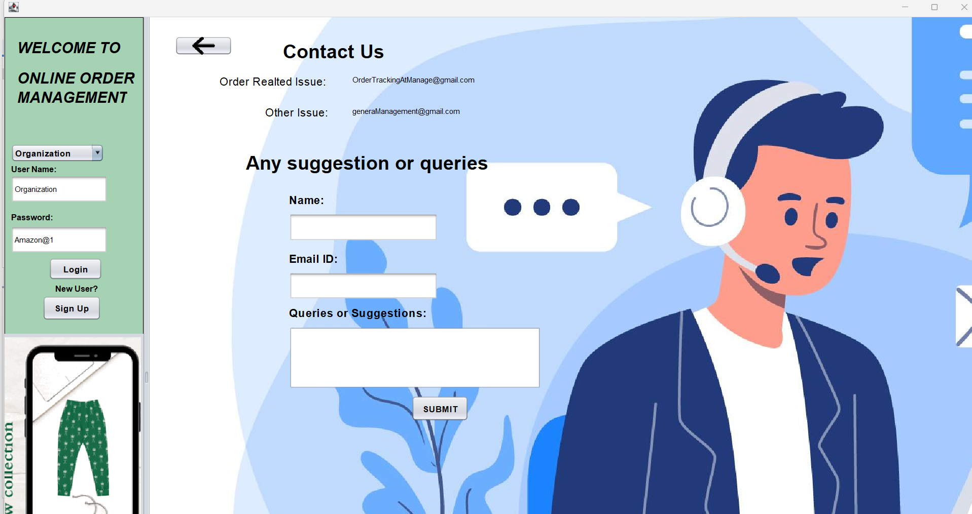

Slide 18
Thank you
Team Heisenberg
Your Order is Delivered
Have a good day

